Slide 1

SLIIT Students’ Attitudes and Preferences Regarding Online Shopping
Aaqib A.R. - IT23228276
Thakkif Ahamed I.M. - IT23223530
Thanis Ahamed A.R. - IT23220942
Erathnage T.N. - IT23222236
Budara V.P.R. - IT23222786

Slide 2
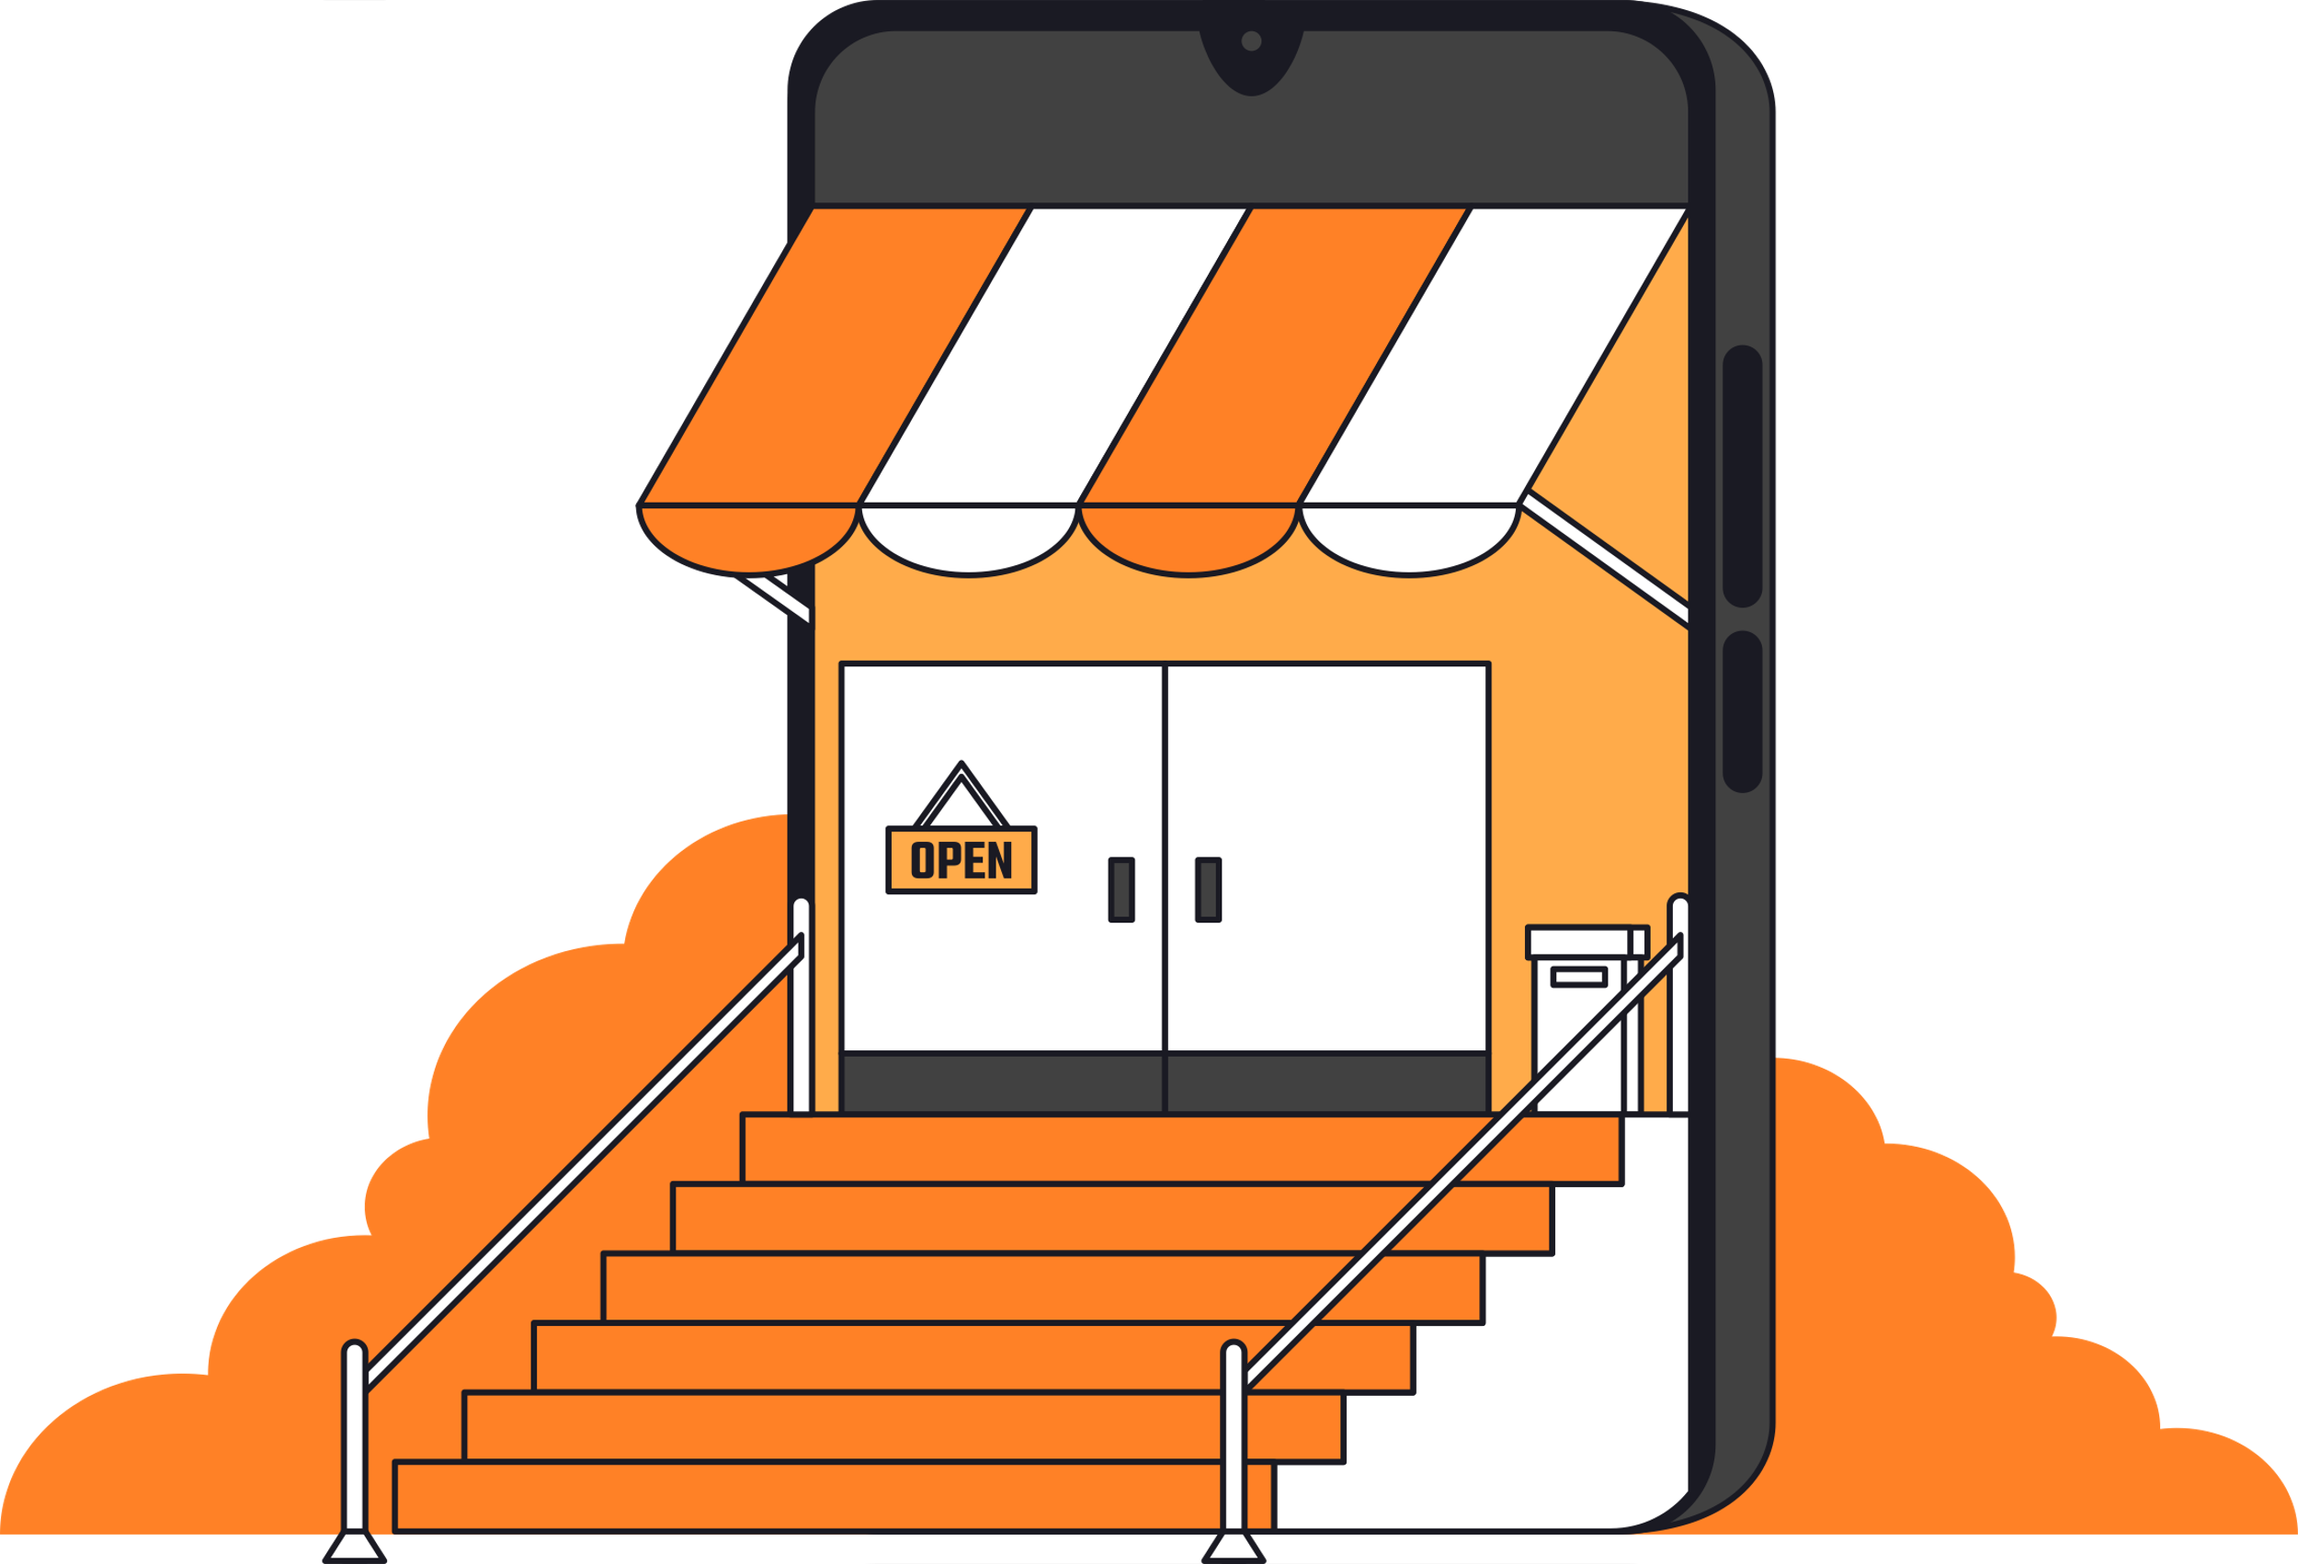


Introduction
Survey Overview
This study explores factors influencing their habits through a survey, offering insights for businesses and policymakers to enhance the online shopping experience.
No. 1
No. 2
Digital Advancements
Tech-savy Nature

Slide 3


Methodology
Target Audience
Undergraduates of SLIIT
Method
Quantitative Approach
Self Administered Questionnaire
(13 Questions)
Designed Using Google Forms
Distributed Via Social Media

Slide 4
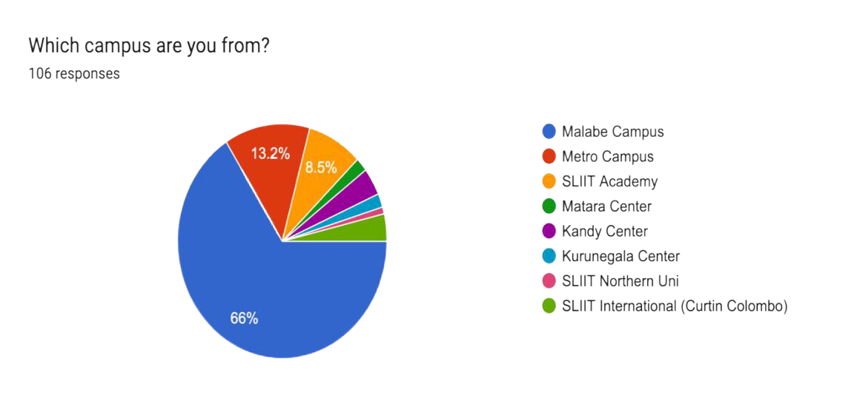
Data Analysis & Discussion
(i) Campus of Studying
Dominance of Malabe Campus
Significant Presence of
Metro Campus

Slide 5
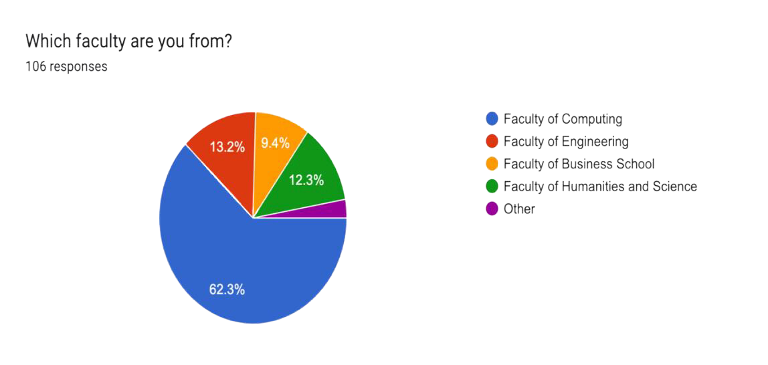
(ii) Faculty of Study
66
- Faculty of Computing
14
- Faculty of Engineering
13
- Faculty of Humanities and Science
10
- Faculty of Business School
03
- Other

Slide 6
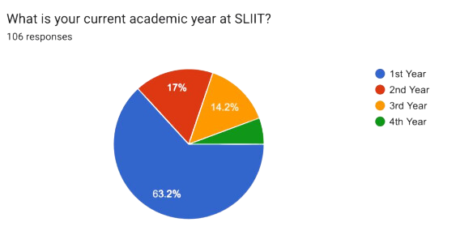
(iii) Academic Year
67
- 1st Year
18
- 2nd Year
15
- 3rd Year
06
- 4th Year

Slide 7
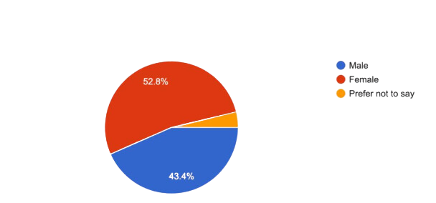



(iv) Gender
56 Females
46 Males

Slide 8
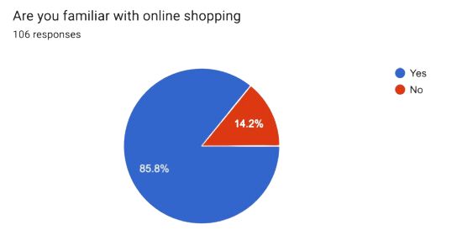
(v) Familiarity with Online Shopping
91
- Yes
15
- No
This pie chart shows Familiarity with Online Shopping among the SLIIT Student

Slide 9
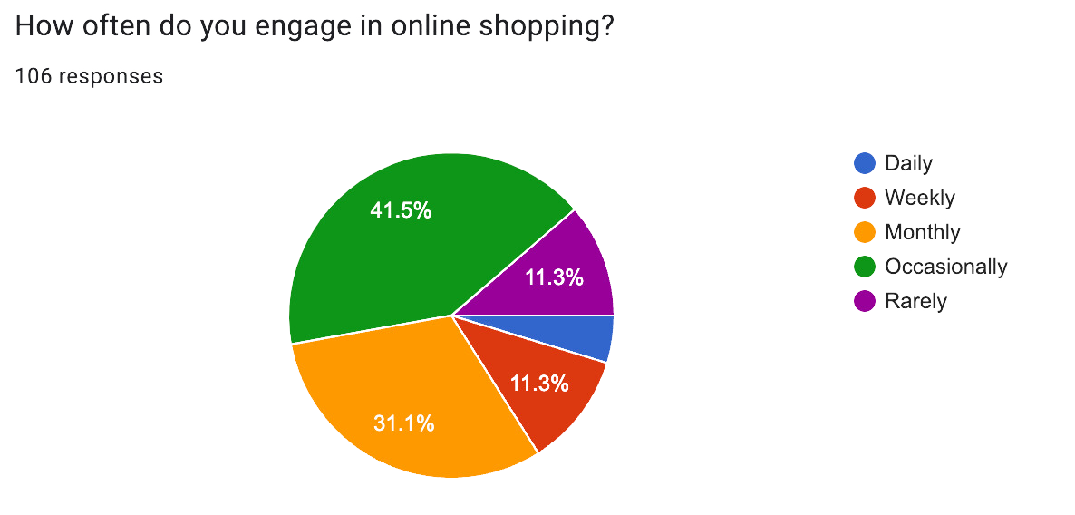
(vi) Engagement on Online Shopping
Daily
Weekly
Occasionally
Monthly
Rarely
This pie chart shows engagement in online shopping among SLIIT Students There 5 options mentioned here Daily, Weekly, Monthly, Occasionally, and Rarely.

Slide 10

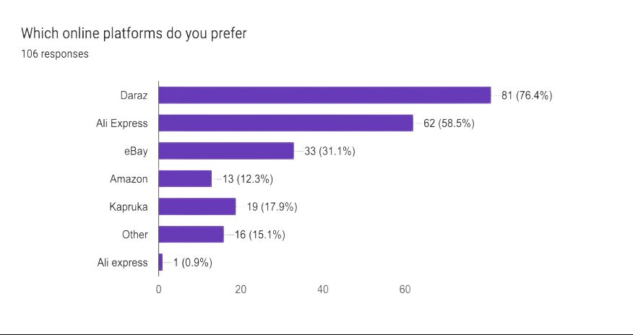




(vii) Preferable Platforms for Online Shopping
Others
This bar chart depicts the preferred Platforms for Online Shopping among SLIIT Students There 6 options mentioned here the are Daraz, Ali Express, eBay, Amazon, Kapruka, and Other platforms

Slide 11

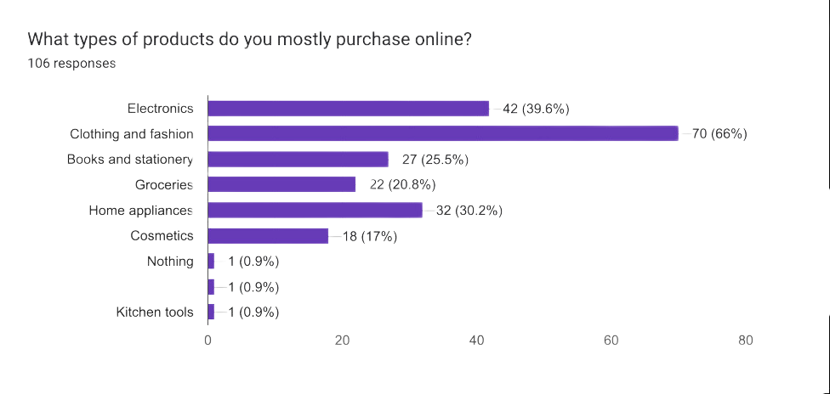

(viii) Most Purchased Product Category
This bar chart depicts Most Purchased Product Category among the SLIIT Student There 8 options mention here the are Electronics, Clothing and fashion, Books and stationery , Groceries, Home appliances, Cosmetics and Kichen tools

Slide 12
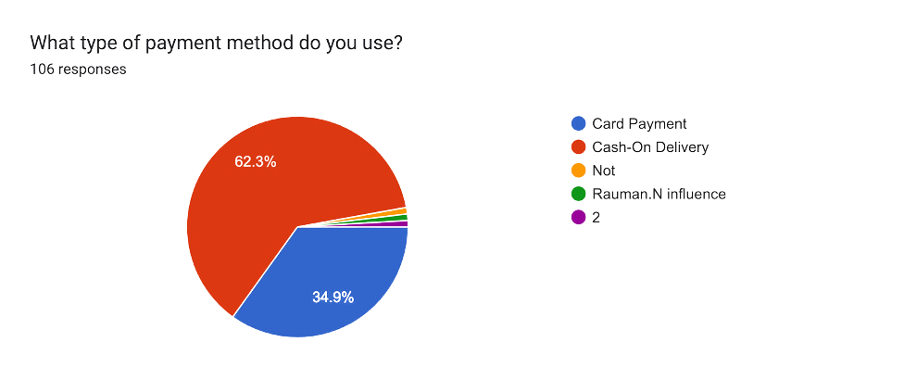


(ix) Payment Method Used for Online Shopping

Slide 13

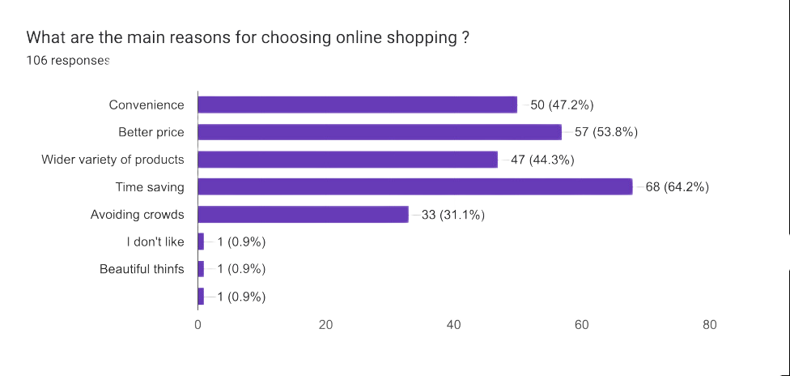
(x) Reasons for Choosing Online Shopping

Slide 14

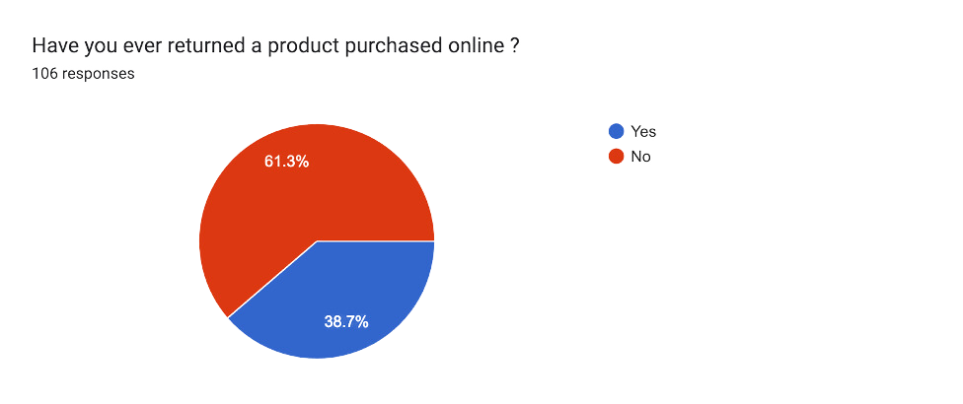

(xi) Product Returns in Online Shopping

Slide 15
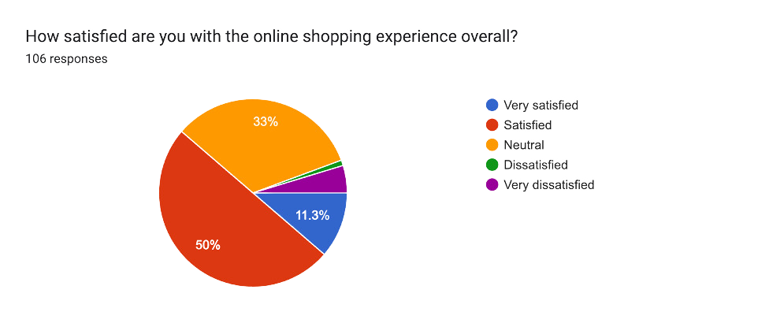

(xii) Satisfaction Based on the Overall Experience

Slide 16

Conclusion
SLIIT students show high familiarity and engagement with online shopping.
Preferences for platforms and product categories are evident.
Convenience and value drive online shopping decisions.
Satisfaction with the online shopping experience is generally high but some express dissatisfaction.

Slide 17

Recommendations
Optimize Platform Accessibility
Diversify Product Offerings
Implement Competitive Pricing
Prioritize Security Measures
Enhance Customer Support
Promote Clear Return Policies
Gather Ongoing Feedback

Slide 18

References
Smith, J., & Johnson, A. (2023). "Understanding Online Shopping Preferences: Insights from SLIIT Students." Journal of Digital Commerce Studies, 8(2), 45-62.
Brown, L., & Patel, R. (2022). "Exploring Consumer Behavior in Digital Commerce: A Study of SLIIT Student Preferences." Int. Conf. on Digital Marketing and E-Commerce Proceedings, 127-140.
Anderson, M., & Wilson, K. (2021). "Factors Influencing Online Shopping Habits: Evidence from SLIIT Student Survey." Journal of Consumer Behavior, 15(4), 321-335.
Garcia, E., & Lee, S. (2020). "The Role of Convenience in Online Shopping Decisions: Insights from SLIIT Students." Int. J. of Retailing and Consumer Services, 28, 87-102.
Patel, N., & Clark, M. (2019). "Understanding Student Satisfaction in Online Shopping: A Comparative Study of SLIIT and Other Universities." J. of Business and Marketing Research, 14(3), 56-70.

Slide 19


Thank You

